Slide 1
LAB 5
Made for Professor Lanham A. by Amrit Singh

Slide 2
AGENDA
Accessing the AWS management console
Task 1 : Create a Security Group for the RDS DB Instance
Task 2 : Create a DB Subnet Group
Task 3 : Create an Amazon RDS DB Instance
Task 4 : Interact with Your Database

Slide 3
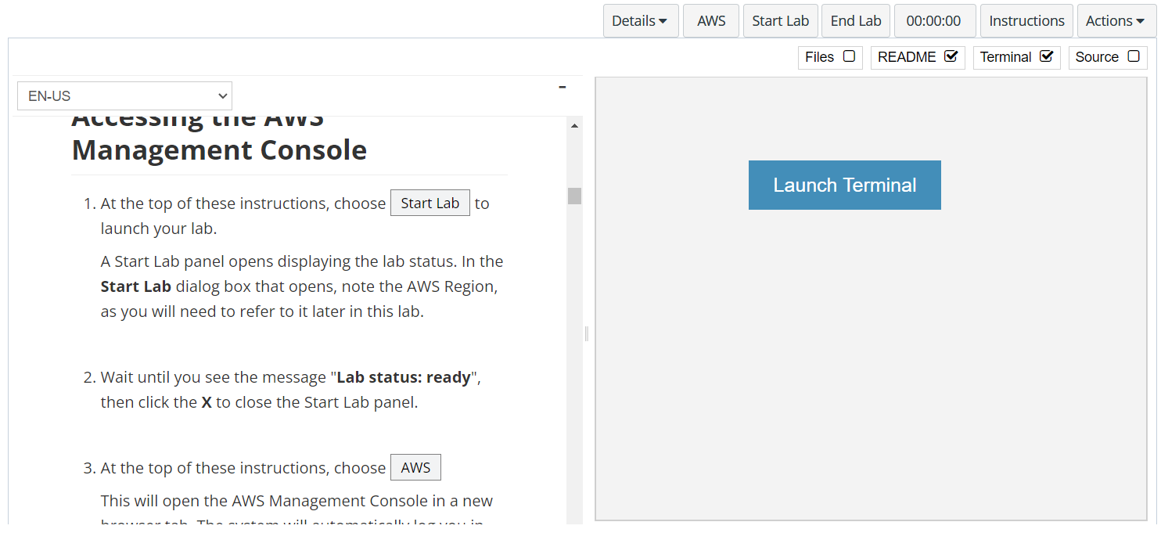
In aws labs click on start lab

Slide 4
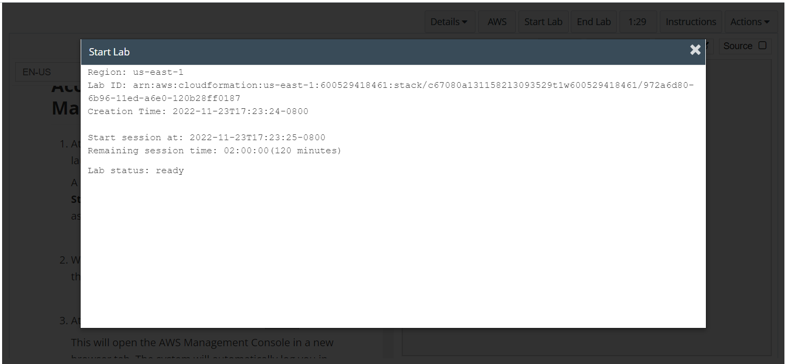
Wait to see lab ready status in the window then press x and click on aws to launch console

Slide 5
Task 1 : Create a New EBS Volume

Slide 6
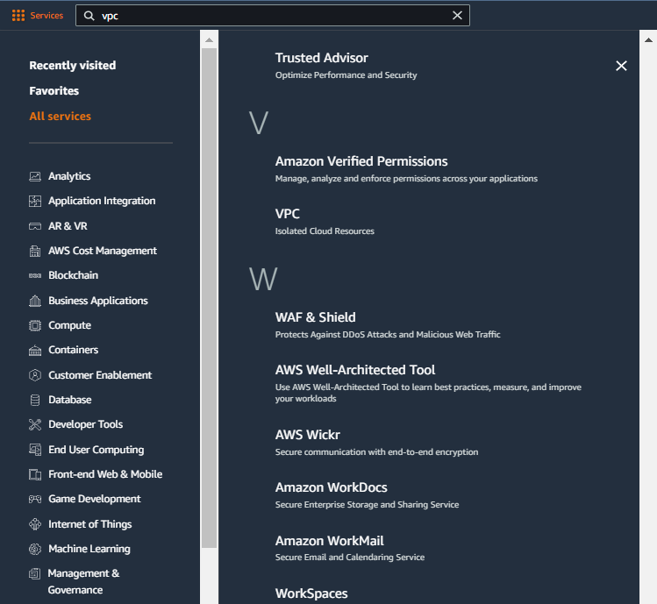
Select services and then click on ec2 button
Click on the Services button
Click on the VPC button

Slide 7
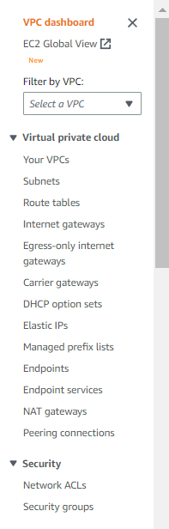
CHOOSE SECURITY GROUPS IN THE NAVIGATION PANE
Click on the security groups in the left pane

Slide 8
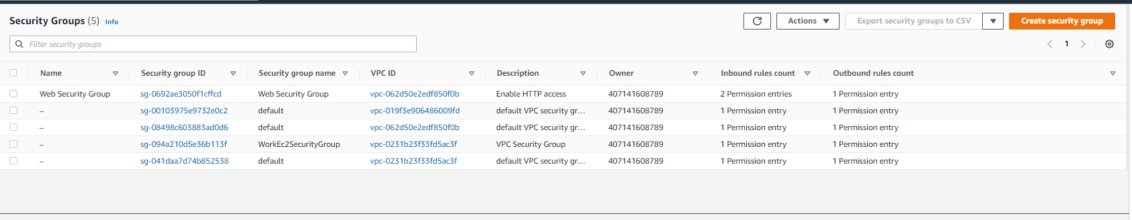
Click on create security groups

Slide 9
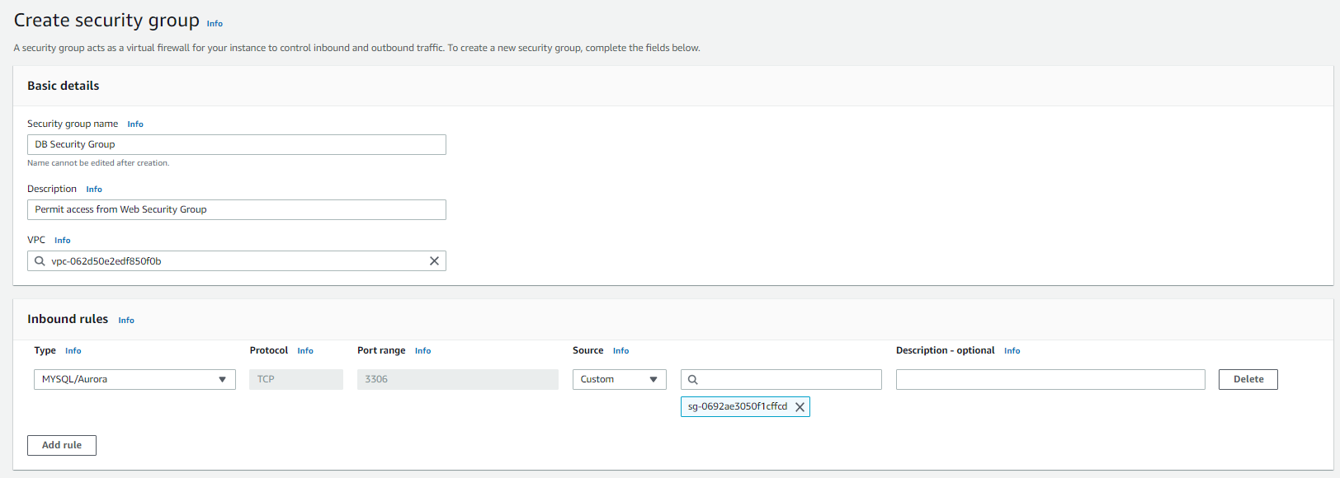
Configure the security group as shown in the labs and add the inbound rule, click on create security group

Slide 10
Task 2 : Create a DB Subnet Group

Slide 11
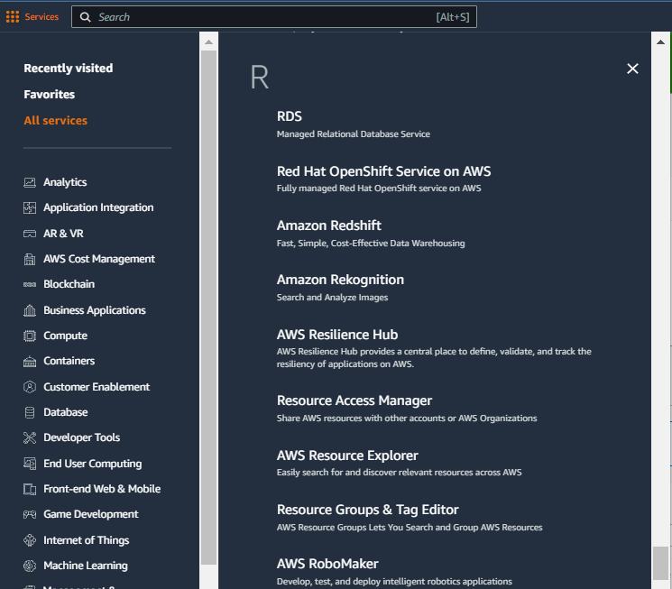
Select services and then click on RDS button
Click on the Services button
Click on the RDS button

Slide 12
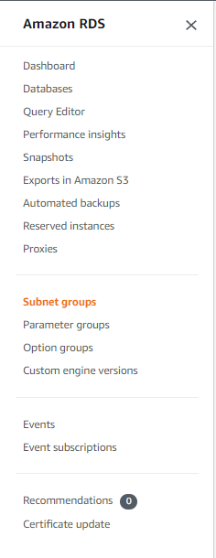
CHOOSE subnet groups IN THE NAVIGATION PANE
Click on the subnet groups in the left pane

Slide 13
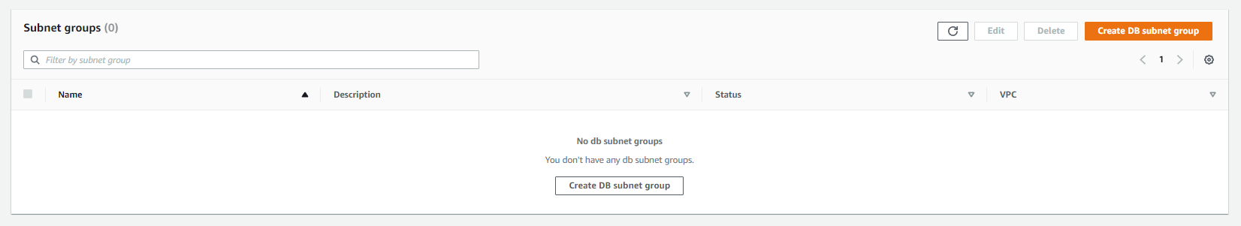
Click on create db subnet group

Slide 14
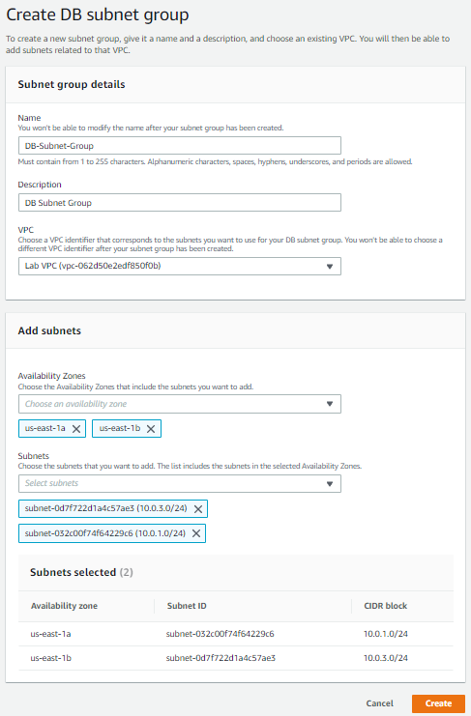
Configure the subnet as shown in the labs and then click on create

Slide 15
Task 3 : Create an Amazon RDS DB Instance

Slide 16
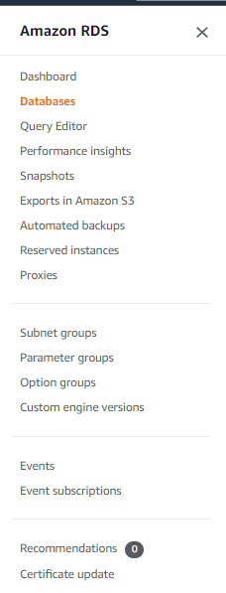
CHOOSE databases IN THE NAVIGATION PANE
Click on the subnet groups in the left pane

Slide 17
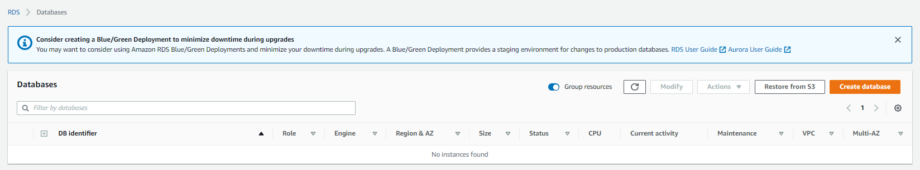
Click on create database button

Slide 18
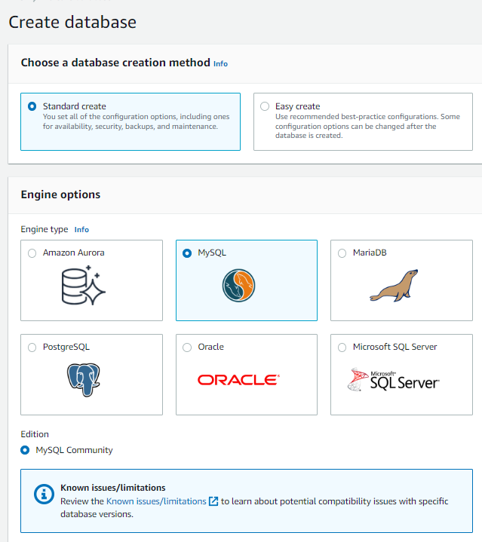
Choose mysql database

Slide 19
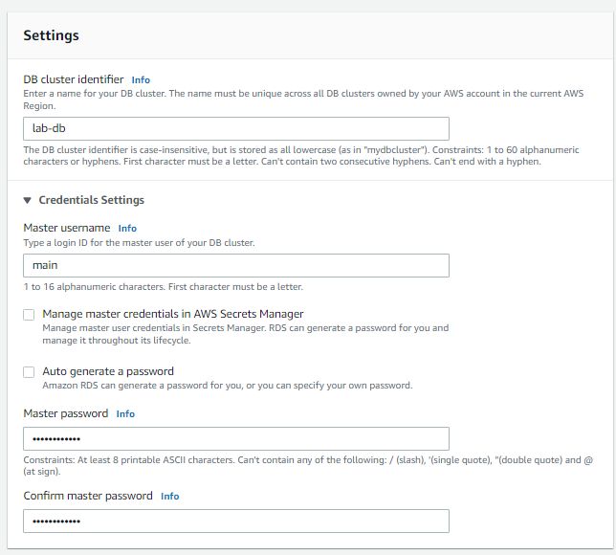
CONFIGURE settings AS shown

Slide 20
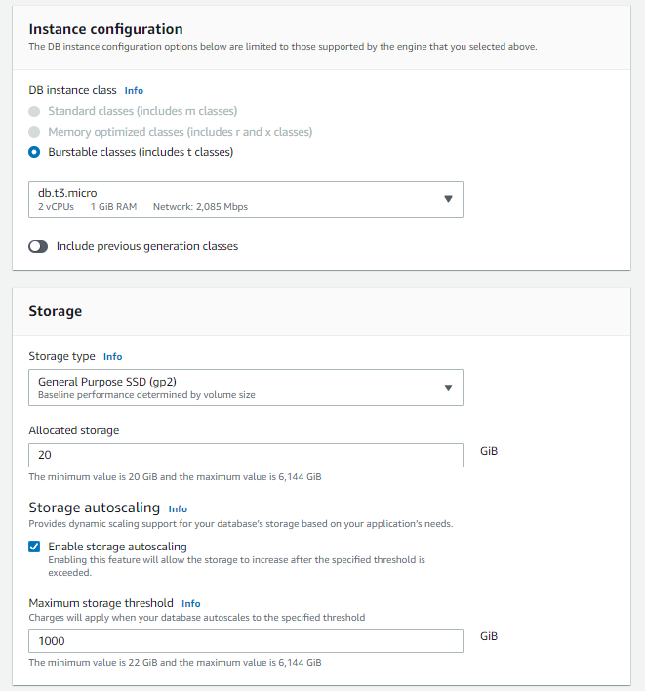
Seelct burstable instances and db.t3.micro under storage select general purpose and allocated storage as 20 GB
Note: In case you are unable to see the burstable instances select free tier in templates

Slide 21
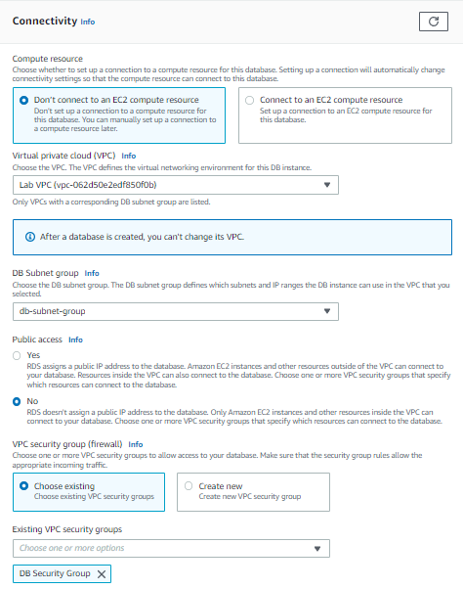
Under connectivity choose lab-vpc and select DB SECURITY GROUP IN SECURITY GROUP AND REMOVE DEFAULT

Slide 22
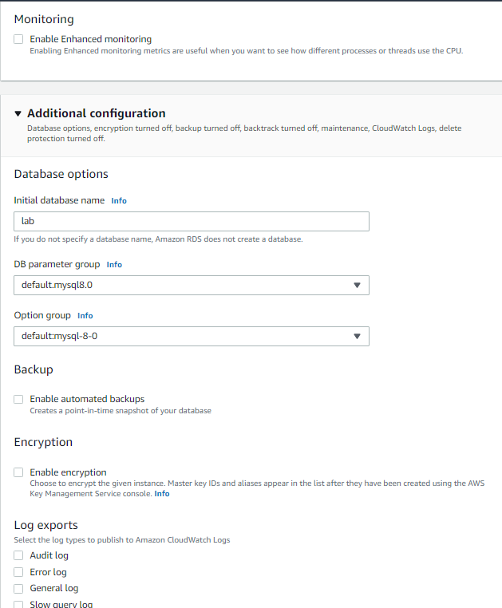
DISBALE ENHANCED MONITORING, DISABLE ENCRYPTION, DISABLE AUTOMATED BACKUPS AND SET INITIAL NAME AS lab and then click create database

Slide 23
Task 4 : Interact with Your Database

Slide 24
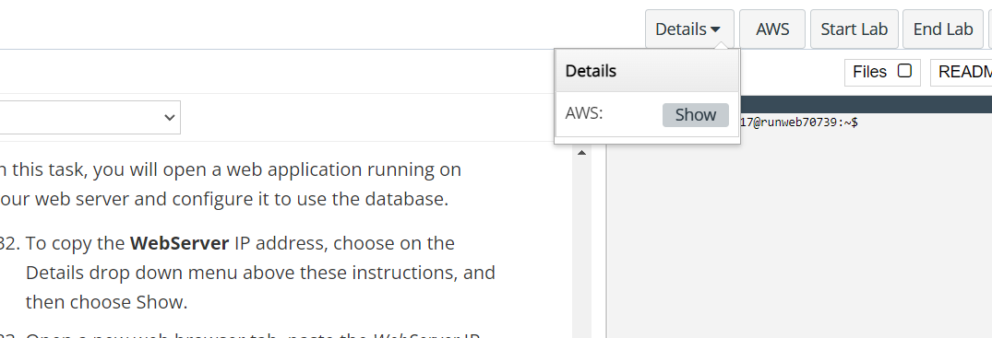
Click on details and then show in aws labs page

Slide 25
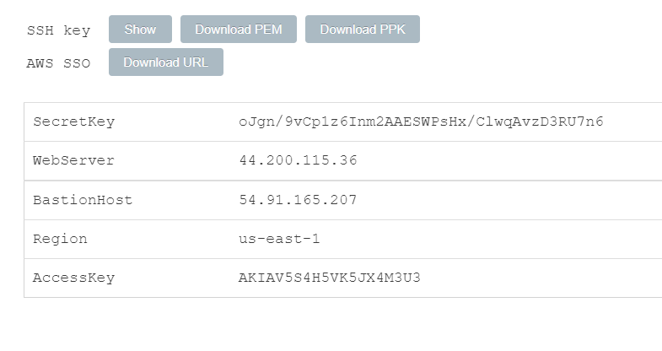
Copy the web server address in a new tab

Slide 26
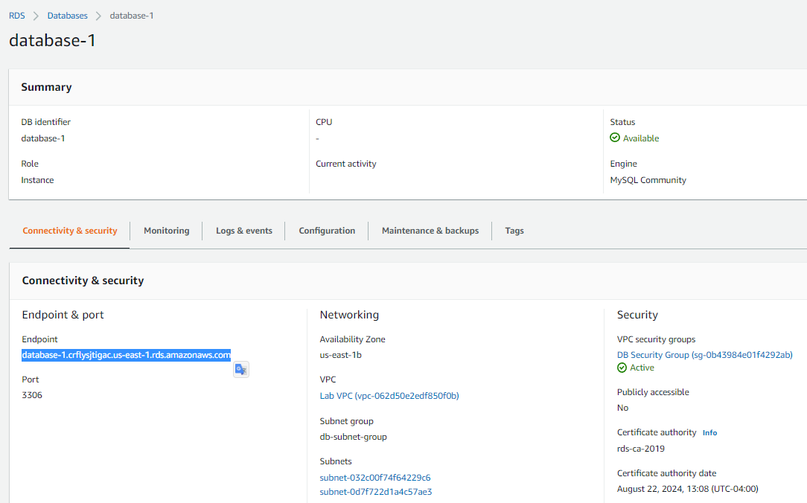
Copy the endpoint of the database you created from connectivity and security subtab

Slide 27
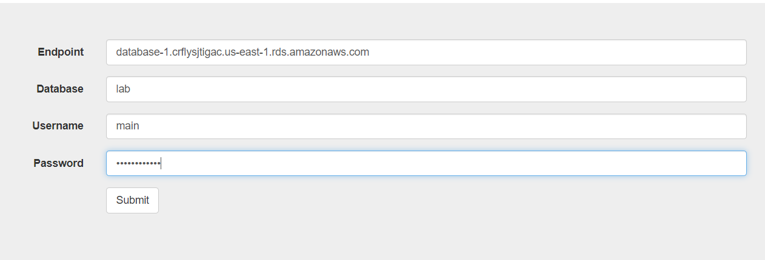
Configure the RDS details as shown in the aws labs and click submit

Slide 28
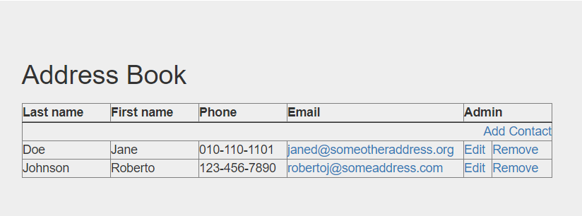
Verify the address book is working by editing the contacts or adding contacts

Slide 29
THANK YOU
Amrit Singh

